Slide 1
PORTFOLIO COVID UNITED STATE &INDIA
.

Slide 2
Introduction
THIS PROJECT CONTAINS INFORMATION ABOUT THE US COVID AND THE INDIA COVID ESTABLISHED THROUGH MYSQL WORKBENCH.
Structured Query Language, or SQL. A database's contents can be stored, modified, and retrieved using SQL, a standard language. The preferred language for interacting with relational databases is SQL. Database records can be added, searched for, updated, and deleted using SQL.
Relational Database Management System is referred to as RDBMS.A program called RDBMS is used to keep a relational database up to date. All contemporary database systems, including MySQL, Microsoft SQL Server, Oracle, and Microsoft Access, are built on RDBMS. RDBMS accesses the data in the database using SQL queries. A popular relational database management system (RDBMS) is MySQL.MySQL is open-source and free. Both small and large applications can benefit from MySQL.

Slide 3
DATABASE USED
US_COVID_DETAILS
INDIA_COVID_DETAILS

Slide 4
Datatype used
INTERGER
A medium integer. Signed range is from -2147483648 to 2147483647. Unsigned range is from 0 to 4294967295. The size parameter specifies the maximum display width (which is 255)
VARCHAR
A VARIABLE length string (can contain letters, numbers, and special characters). The size parameter specifies the maximum string length in characters - can be from 0 to 65535

Slide 5
Sql constraints
PRIMARY KEY
The PRIMARY KEY constraint uniquely identifies each record in a table. Primary keys must contain UNIQUE values, and cannot contain NULL values. A table can have only ONE primary key; and in the table, this primary key can consist of single or multiple columns (fields).
TRIGGER
An SQL trigger is a database object that is associated with a table and automatically executes a set of SQL statements when a specific event occurs on that table. Triggers are specific to the table on which they are defined. They can be created on a single table or view and can access and modify data within that table or other related tables.

Slide 6
Table creation
US COVID DETAILS:
create table US_COVID_Det
(
S_No int,States_
US varchar(20),
Positive_Performance int,
Death_Performance int,
Recovered_Performance int,
Total_Population int,
Rank_Population int,
Primary Key (S_No)
);

Slide 7
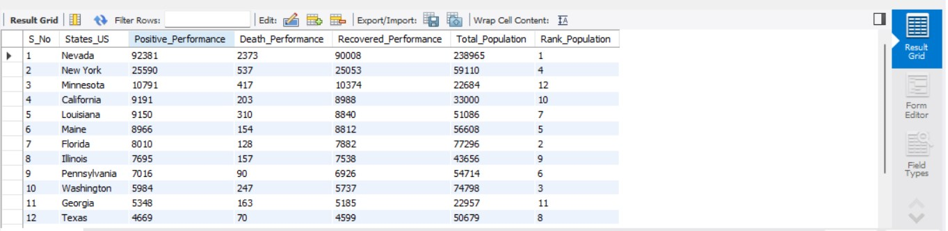
Us covid details table

Slide 8
INDIA COVID DETAILS
create table Ind_Covid_Det
(
S_No int primary key,
States_india varchar(20),
Positive_Performance_Ind int,
Death_Performance_Ind int,
Recovered_Performance_Ind int,
Total_Population_Ind int,
Rank_Population_Ind int
);

Slide 9
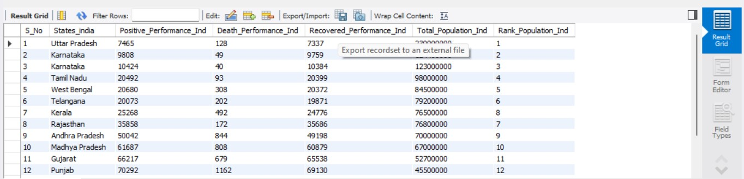
India covid details table

Slide 10
join
Based on a shared column between two or more tables, a JOIN clause is used to merge rows from those tables.
Many JOIN types in SQL are as follows
--- INNER JOIN: Returns records that have matching values in both tables
--- LEFT (OUTER) JOIN: Returns all records from the left table, and the matched records from the right table
--- RIGHT (OUTER) JOIN: Returns all records from the right table, and the matched records from the left table
--- FULL (OUTER) JOIN: Returns all records when there is a match in either left or right table

Slide 11
Case statement
The CASE statement goes through conditions and returns a value when the first condition is met (like an if-then-else statement). So, once a condition is true, it will stop reading and return the result. If no conditions are true, it returns the value in the ELSE clause.If there is no ELSE part and no conditions are true, it returns NULL.
Syntax:
CASE
WHEN condition1 THEN result1
WHEN condition2 THEN result2
WHEN conditionN THEN resultN
ELSE result
END;

Slide 12
Trigger query
Create view US_INDIA_COVID as select ind_Covid_Det.S_No,states_india,Positive_Performance_Ind,concat(round((Positive_Performance_Ind/Total_Population_Ind)*100,2),'%') as Positive_Ratio_india,Death_Performance_Ind,concat(Round((Death_Performance_Ind/Positive_Performance_Ind)*100,2),'%') as Death_Ratio_india,Recovered_Performance_Ind,concat(round((Recovered_Performance_Ind/Positive_Performance_Ind)*100,2),'%') as Recovered_Ratio_india,Total_Population_Ind, Rank_Population_Ind,
case
when concat(round((Positive_Performance_Ind/Total_Population_Ind)*100,2),'%') >=10
Then
casewhen concat(round((Positive_Performance_Ind/Total_Population_Ind)*100,2),'%')>=10 and concat(round((Positive_Performance_Ind/Total_Population_Ind)*100,2),'%')<=20 then "Average Spread" when concat(round((Positive_Performance_Ind/Total_Population_Ind)*100,2),'%')>=20 and concat(round((Positive_Performance_Ind/Total_Population_Ind)*100,2),'%')<=30 then "Low MIddle Spread"when concat(round((Positive_Performance_Ind/Total_Population_Ind)*100,2),'%')>=30 and concat(round((Positive_Performance_Ind/Total_Population_Ind)*100,2),'%')<= 50 then "High Middle Spread"when concat(round((Positive_Performance_Ind/Total_Population_Ind)*100,2),'%')>=50 and concat(round((Positive_Performance_Ind/Total_Population_Ind)*100,2),'%')<=80 then "Peak Spread"else "High Peak Spread"
end

Slide 13
.
else "Low Level Spread“
end
as Covid_Positive_Grade_india,(Total_Population_Ind-Positive_Performance_Ind) as Negative_Performance_india,concat(round(((Total_Population_Ind-Positive_Performance_Ind)/Total_Population_Ind-Positive_Performance_Ind)*100,2),'%') as Negative_People_Ratio_india,case when concat(round(((Total_Population_Ind-Positive_Performance_Ind)/Total_Population_Ind)*100,2),'%')>=20
then
Case
when
concat(round(((Total_Population_Ind-Positive_Performance_Ind)/Total_Population_Ind)*100,2),'%')>=20 and concat(round(((Total_Population_Ind-Positive_Performance_Ind)/Total_Population_Ind)*100,2),'%')<=50 then "Low Level Immunity State People"when concat(round(((Total_Population_Ind-Positive_Performance_Ind)/Total_Population_Ind)*100,2),'%')>=50 and concat(round(((Total_Population_Ind-Positive_Performance_Ind)/Total_Population_Ind)*100,2),'%')<=60 then "Average Level Immunity State People"when concat(round(((Total_Population_Ind-Positive_Performance_Ind)/Total_Population_Ind)*100,2),'%')>=60 and concat(round(((Total_Population_Ind-Positive_Performance_Ind)/Total_Population_Ind)*10/0,2),'%')<=80 then "High Level Immunity State People"else "Peak Level Immunty State People“
End
else
"Very Low Immunity State People"end as State_Immunity_Level_india,States_Us,Positive_Performance,Death_Performance,Recovered_Performance,Total_Population, Rank_population,concat(Round((death_performance/positive_performance)*100,2),'%') as Death_Ratio,concat(round((Recovered_Performance/Positive_Performance)*100,2),'%') as Recovered_Ratio,concat(round((Positive_Performance/Total_Population)*100,2),'%') as Positive_Ratio,case when concat(round((Positive_Performance/Total_Population)*100,2),'%') >=10then

Slide 14
.
Case
when
concat(round((Positive_Performance/Total_Population)*100,2),'%')>=10 and concat(round((Positive_Performance/Total_Population)*100,2),'%')<=20 then "Average Spread"
when
concat(round((Positive_Performance/Total_Population)*100,2),'%')>=20 and concat(round((Positive_Performance/Total_Population)*100,2),'%')<=30 then "Low MIddle Spread“
when
concat(round((Positive_Performance/Total_Population)*100,2),'%')>=30 and concat(round((Positive_Performance/Total_Population)*100,2),'%')<= 50 then "High Middle Spread“
When
concat(round((Positive_Performance/Total_Population)*100,2),'%')>=50 and concat(round((Positive_Performance/Total_Population)*100,2),'%')<=80 then "Peak Spread"else "High Peak Spread"
end
else "Low Level Spread“
End
as Covid_Positive_Grade,(Total_Population-Positive_Performance) as Negative_Performance,concat(round(((Total_Population-Positive_Performance)/Total_Population)*100,2),'%') as Negative_People_Ratio,case when concat(round(((Total_Population-Positive_Performance)/Total_Population)*100,2),'%')>=20then casewhen concat(round(((Total_Population-Positive_Performance)/Total_Population)*100,2),'%')>=20 and concat(round(((Total_Population-Positive_Performance)/Total_Population)*100,2),'%')<=50 then "Low Level Immunity State People"when concat(round(((Total_Population-Positive_Performance)/Total_Population)*100,2),'%')>=50 and concat(round(((Total_Population-Positive_Performance)/Total_Population)*100,2),'%')<=60 then "Average Level Immunity State People"when concat(round(((Total_Population-Positive_Performance)/Total_Population)*100,2),'%')>=60 and concat(round(((Total_Population-Positive_Performance)/Total_Population)*100,2),'%')<=80 then "High Level Immunity State People"else "Peak Level Immunty State People"end else "Very Low Immunity State People"end as State_Immunity_Level from Ind_Covid_Det inner join Us_Covid_Det on Ind_Covid_Det.Rank_Population_Ind = Us_Covid_Det.rank_populationorder by rank_population asc;

Slide 15
.
End
as Covid_Positive_Grade,(Total_Population-Positive_Performance) as Negative_Performance,concat(round(((Total_Population-Positive_Performance)/Total_Population)*100,2),'%') as Negative_People_Ratio,case when concat(round(((Total_Population-Positive_Performance)/Total_Population)*100,2),'%')>=20
then
Case
when concat(round(((Total_Population-Positive_Performance)/Total_Population)*100,2),'%')>=20 and concat(round(((Total_Population-Positive_Performance)/Total_Population)*100,2),'%')<=50
then "Low Level Immunity State People“
when concat(round(((Total_Population-Positive_Performance)/Total_Population)*100,2),'%')>=50 and concat(round(((Total_Population-Positive_Performance)/Total_Population)*100,2),'%')<=60
then "Average Level Immunity State People“
when concat(round(((Total_Population-Positive_Performance)/Total_Population)*100,2),'%')>=60 and concat(round(((Total_Population-Positive_Performance)/Total_Population)*100,2),'%')<=80
then "High Level Immunity State People“
else "Peak Level Immunty State People“
end
else "Very Low Immunity State People“
end

Slide 16
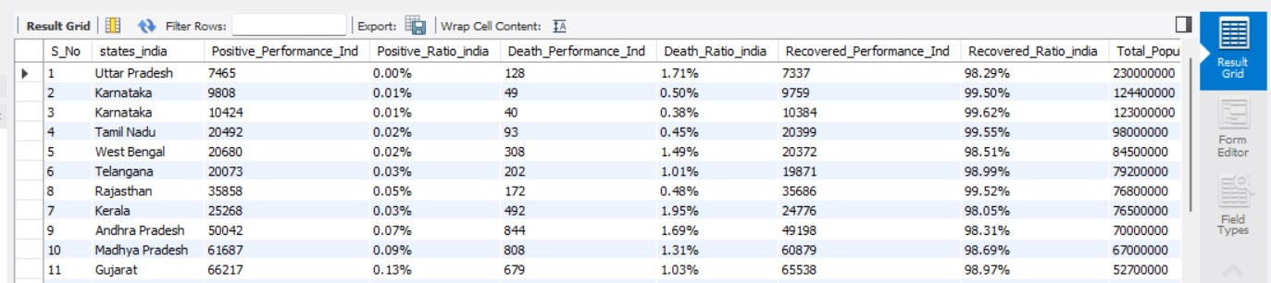
.
as State_Immunity_Level from Ind_Covid_Det inner join Us_Covid_Det on Ind_Covid_Det.Rank_Population_Ind = Us_Covid_Det.rank_populationorder by rank_population asc;

Slide 17
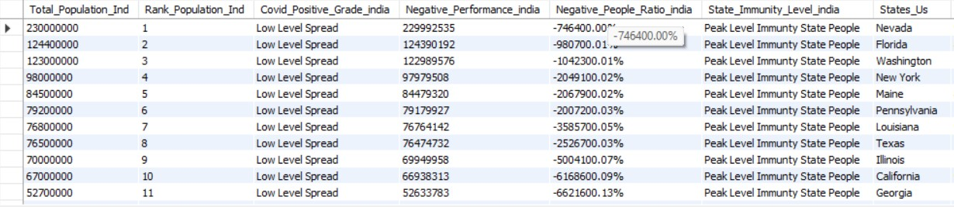
.

Slide 18
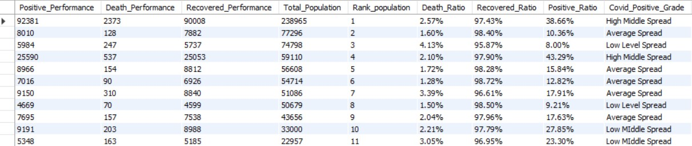
.

Slide 19
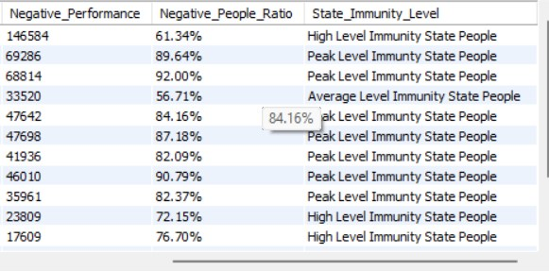
.

Slide 20
.
THANK YOU

